Slide 1

Network models
Notes:
In this video we’re going to start to look at modelling networks, which in some sense is the topic of the rest of the course.

Slide 2
What can networks do?
Anything!
Notes:
A key question we might want to answer is: what can networks do that single neurons can’t?
***
The simple answer is that they can do anything, which makes it tricky to decide what to include in a short video like this.
Let’s first unpack what I mean by that.

Slide 3
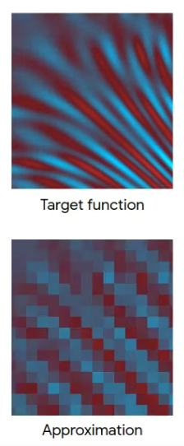

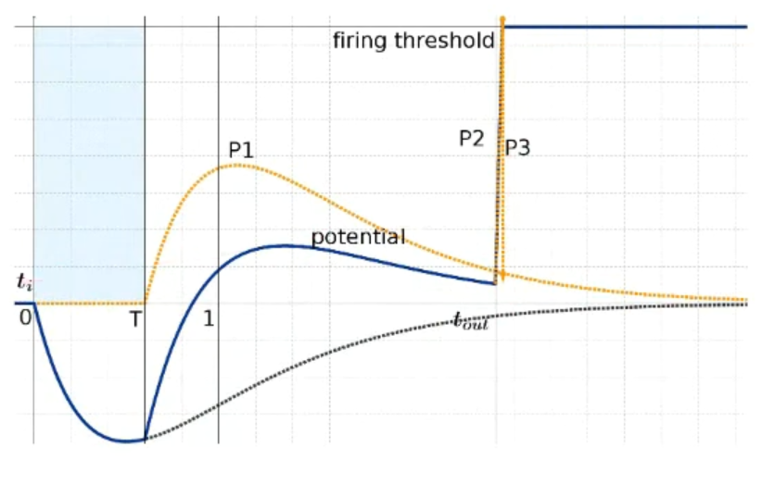
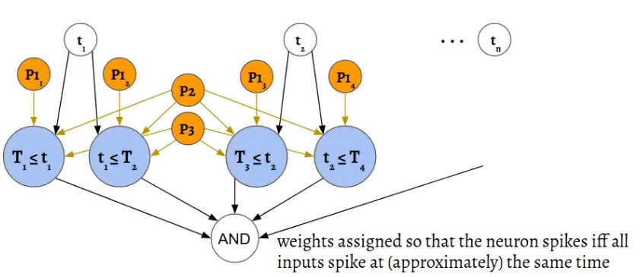

Universal function approximation
McCulloch and Pitts (1943): SNNs can implement any logical function
Spiking neural networks are universal function approximators
→ They can approximate any (well behaved) function
Comsa et al. (2019, 2020) have a nice proof for networks with alpha synapses:
You can implement “$≤$” and “$≥$”.
Using an AND network you can express intervals or hypercubes.
Split function domain into intervals/hypercubes to approximate any function.
https://snufa.net
Notes:
If you watched the history of neuroscience video, you’ll know that as early as 1943 McCulloch and Pitts showed that spiking neural networks could implement any logical function.
***
And we don’t need to limit ourselves to logical functions. Just as for artificial neural networks, spiking neural networks are universal function approximators. That is, they can approximate any reasonable function.
***
This has been proven in various ways by different people over the years, but I’m going to highlight a particularly nice and simple proof by Iulia Comsa at Google Research.
***
She gave a great talk about this at a conference I co-organise called SNUFA, which stands for “spiking neural networks as universal function approximators”. If you like this course, you might find some of the research presented there interesting too, and it’s all available to watch on Youtube. I’ve included a link in the reading material to SNUFA, and to Iulia’s talk and paper.
***
Her paper starts by showing that you can implement the less than and greater than operators using spiking neurons. We’ll do a similar thing in this week’s exercise.
***
Next, by adding in a network that implements logical-AND, you can express intervals or – in higher dimensions – hypercubes.
***
Finally, by combining these you can approximate any function to as much accuracy as you want by just dividing into smaller and smaller hypercubes.
OK, so that’s great and perhaps not unexpected given that our brains are just spiking neural networks and we like to think we’re fairly capable.
But it does mean that there’s no way we can cover all the things we can do with networks. So instead, what I’m going to do is talk through in detail one particular type of network that I’ve been interested in during my research career, and show how it ties in to some of the concepts that neuroscientists use to understand the brain.

Slide 4
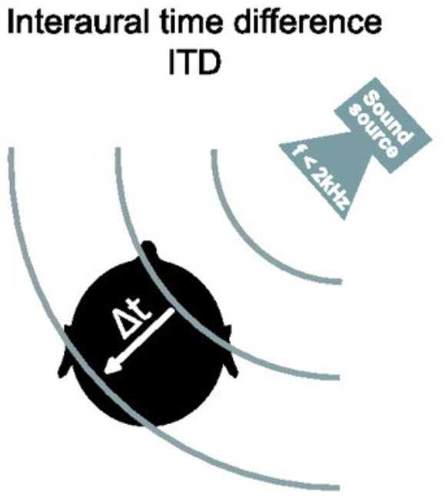

Sound localisation circuit
Constant travel speed for signal
Coincidence detector cell
Left ear
Right ear
$Δt=$ 2
Input left
Input right
Notes:
The circuit we’ll look at is the sound localisation circuit. One of the key ways we can tell which direction a sound is coming from is because there’s an arrival time difference of the sound between the two ears. Depending on head size and the angle the sound is arriving from, for humans this is a maximum of around 650 microseconds. We’re able to discriminate sounds arriving with a time difference as small as 20 microseconds, and some animals like owls can discriminate differences as small as just a few microseconds. So how can we detect this?
***
One model is due to Lloyd Jeffress in 1948 and still found in textbooks, although the reality is a bit more complicated as we’ll see.
In his model, you have an array of what are sometimes called coincidence detector neurons. These are neurons that will only fire a spike if they receive a simultaneous input from both their synapses.
The signal arrives from the left ear, and travels at constant speed along this pathway, arriving at each neuron with a slightly different delay.
At the same time, the signal arrives from the right ear and does the same thing but in the reverse direction. When the acoustic delays exactly cancel with the neural delays, the signal will arrive at the coincidence detector at the same time and cause it to spike, and we can use the identity of which neuron fired a spike to tell us where the sound came from.
***
Let’s see that in action for this example sound. You can see that it arrives first at the left ear in the third window, and then in the right ear in the 5th window, so there’s a 2 window time difference. Now let’s see what happens in that circuit
*** ANIMATION
When the sound happens, the signal appears at the left and starts moving right, and then at the right moving left.
They arrive at this cell at the same time, and it lights up.
So that’s how Jeffress’ model of sound localisation works, and it has a few interesting and more general features that we can dig into.

Slide 5
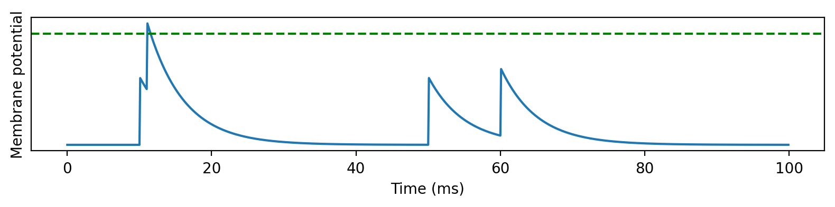
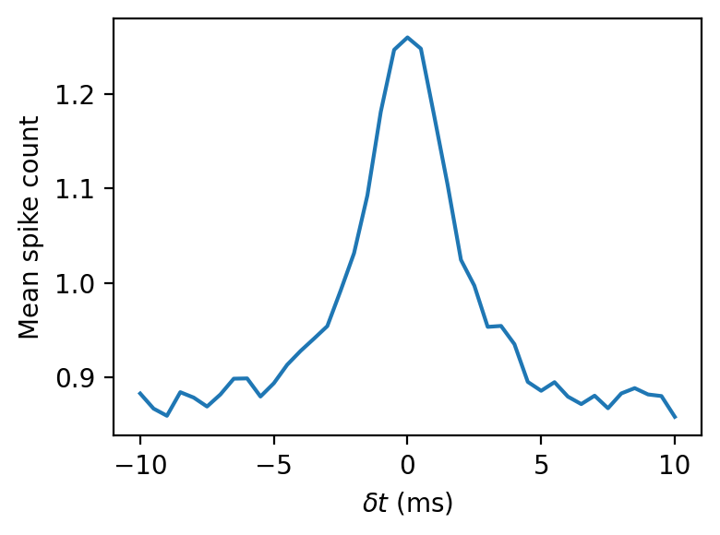

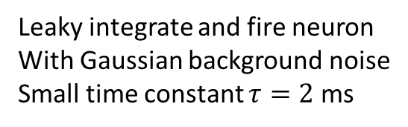

Coincidence detection and tuning curves
Spike timing tuning curve
Spike at time $t_{1}$
Spike at time $t_{2}$
Leaky integrate and fire neuron
With Gaussian background noise
Small time constant $τ=2$ ms
Notes:
The first is coincidence detection.
***
It’s actually quite a general property of leaky neurons, precisely because of the leak, as you can see in this picture.
When two spikes arrive at similar times, they’re enough to drive the neuron over threshold and cause a spike.
Whereas when they arrive with a larger time difference, the leak between the spikes means the peak is lower and not enough to drive it over threshold.
***
We can plot the effect of this on a neuron that receives two spikes, and to make it a bit more realistic, a fluctuating, Gaussian background noise.
***
Here’s what we get. You can see that the neuron fires more spikes when the arrival time difference between the spikes is smaller. Precisely what we want.
***
This is one example of what’s called a tuning curve in neuroscience. It shows the response of a neuron, averaged over several repetitions, to a stimulus defined by one or more variables. In this case, the variable is the arrival time difference between the two spikes, but it could be anything, like the contrast of a visual image, the amplitude or pitch of a sound, and so on. It can also be 2D in which case you’d plot it as an image. We’ll come back to tuning curves a bit later.

Slide 6
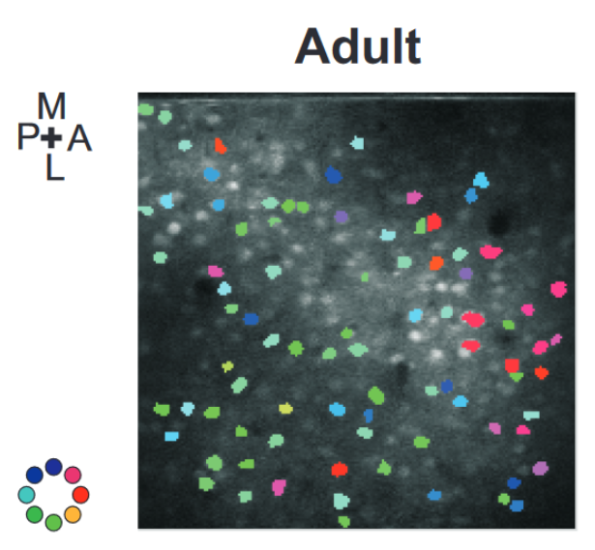
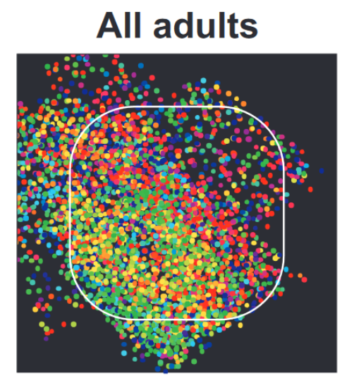
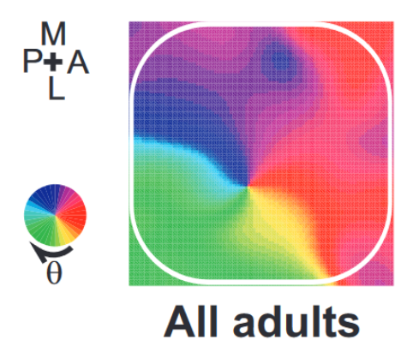
Spatial structure
Prefers sounds that arrive at left ear first
Left ear
Right ear
Prefers sounds that arrive at right ear first
Prefers sounds that arrive at both ears at the same time
Notes:
Another aspect of this network that you see many times in neuroscience is the spatial structure.
The cells here are in a 1 dimensional array in order of their preferred difference in arrival time.
You see this sort of pattern in 1D and 2D across the brain in auditory, visual and other modalities.
***
Here’s an example from the barrel cortex of the rat. That’s the part of the brain that processes inputs from the rats’ whiskers. The coloured blobs shows the preferred stimulation direction of the cell recorded at that position. The spatial structure isn’t obvious because there are so few cells recorded.
***
But, you start to see it if combine across multiple animals.
***
And with a bit of smoothing it becomes even clearer.
One interesting feature of this is that it’s learned. You don’t see it in young rats, only adults.
In terms of modelling, it’s fairly easy to just add some metadata to each neuron specifying its position, and use that in your models, for example to make connections between nearby neurons more likely than between neurons that are far away.

Slide 7

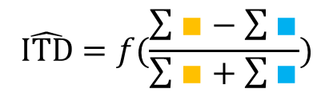
Encoding and decoding
Left ear
$$\hat{ITD}=f(argmax_{i}∎)$$
1-hot encoding
Right ear
Left ear
$$\hat{ITD}=f(\frac{\sum{∎}−\sum{∎}}{\sum{∎}+\sum{∎}})$$
Regression
Right ear
Prefer left
Multiclass perceptron
Prefer right
Notes:
With the idea of tuning curves and spatial structure in mind we can talk about how information is encoded and decoded in this network.
Essentially, the model Jeffress proposed is what we would now call a 1-hot encoding. Knowing the identity or index of the most active neuron tells you the category of the data, in this case a value put into one of several discrete intervals.
More recently, it was noted that in the presence of neural noise, this isn’t a very robust way of decoding that information.
***
David McAlpine and colleagues proposed an alternative view of what the brain might be doing to decode information from this network. Their idea was to take the difference of the summed activities of the cells that prefer right leading sounds to those that prefer left leading sounds, and to use this 1d variable to regress the location. It turns out this is much more robust to noise. Conceptually, this is because by summing or equivalently averaging all the activity of the cells, you reduce the effect of noise.
***
In 2013 I wrote a paper that I can summarise here by saying that you can do better than either of these approaches by using a standard multiclass perceptron. This makes use of all the information in a way that neither of the other two models does, including averaging out the noise. In one of those strange twists of fate, the same year our paper came out, another paper came out from the lab I had just moved to that was basically the same, only they used a Bayesian decoding framework rather than perceptrons, and so I’ll use their paper to talk about that framework.

Slide 8
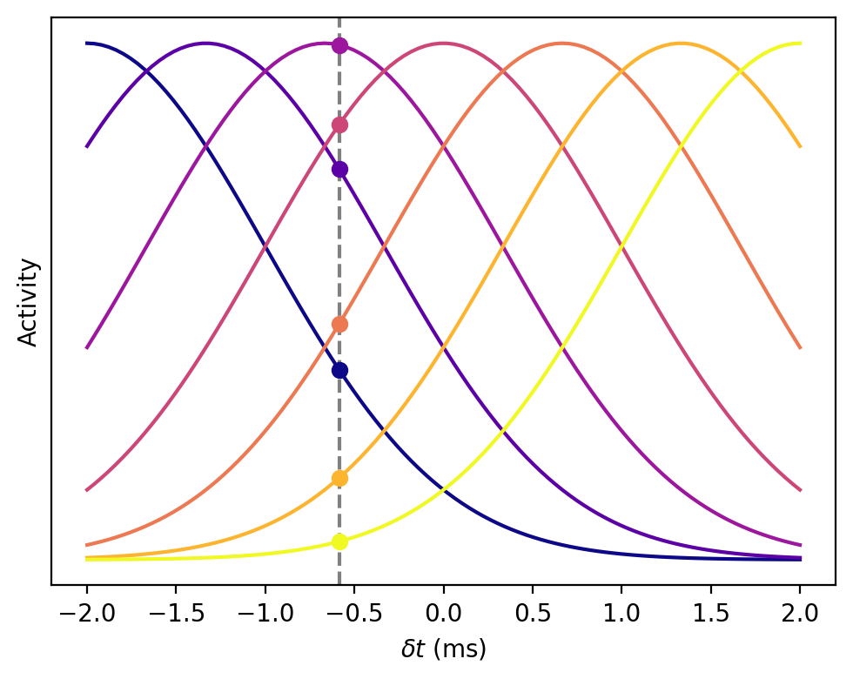
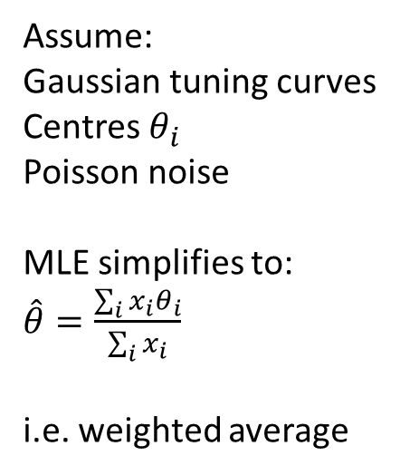
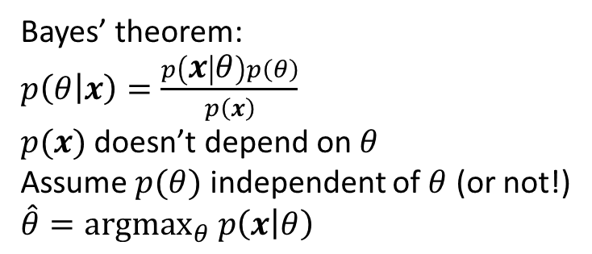
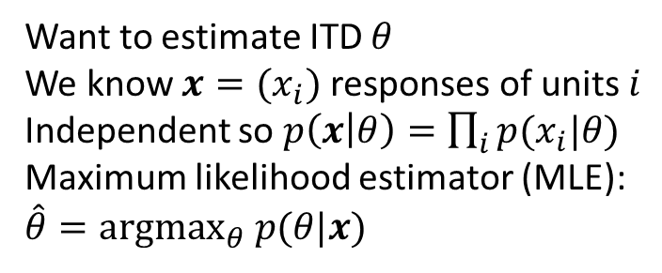
Maximum likelihood and Bayesian estimators
Left ear
Assume:
Gaussian tuning curves
Centres $θ_{i}$
Poisson noise
MLE simplifies to:
$\hat{θ}=\frac{\sum_{i}{x_{i}θ_{i}}}{\sum_{i}{x_{i}}}$
i.e. weighted average
Population
Right ear
Want to estimate ITD $θ$
We know $x=(x_{i})$ responses of units $i$
Independent so $p\left(x | θ\right)=\prod_{i}{p(x_{i}|θ)}$
Maximum likelihood estimator (MLE):
$\hat{θ}=argmax_{θ} p(θ|x)$
Bayes’ theorem:
$p\left(θ | x\right)=\frac{p\left(x | θ\right)p\left(θ\right)}{p\left(x\right)}$
$p(x)$ doesn’t depend on $θ$
Assume $p(θ)$ independent of $θ$ (or not!)
$\hat{θ}=argmax_{θ} p\left(x | θ\right)$
Notes:
We’ve seen how we have an array of coincidence detectors whose response is larger or smaller depending on the arrival time difference of the sound.
***
Now imagine we plot all the tuning curves on top of each other for this population of neurons.
If the ITD were here where the grey vertical line is, then we’d see the responses at these circles, and the idea is to use that pattern of responses to work out the ITD.
If there were no noise, you could just read it out easily from this figure, but these responses are very noisy so we have to use a probabilistic method. Here’s one very common way to do that.
*******
We want to estimate the ITD theta.
We know the neural responses as a vector x.
We assume they’re independent so we can easily compute the probability of a given vector of responses given a value of theta.
Then our maximum likelihood estimator is the value of theta that makes the observed response the most likely. But we don’t know this probability of theta given x, only the reverse.
***
That’s where Bayes’ theorem comes in because it lets us calculate one in terms of the other.
In particular, since we’re computing an argmax over theta, we can ignore any term that doesn’t depend on theta, so we can ignore this p(x).
If we assume that all values are equally likely we can also ignore the p(theta) term. If we have a prior of which ITDs are more likely than others, we can incorporate this here and then the method is known as maximum a posteriori or MAP estimation.
Now we can express the estimate we want in terms of things we can calculate.
***
That all seems quite abstract probably, but in this case if we make some additional assumptions it simplifies nicely. Let’s assume the shape of these tuning curves is approximately Gaussian centred on some preferred ITD theta_i. We also assume that the noise is Poisson distributed (which is a reasonable model).
With these assumptions, the maximum likelihood estimator simplifies just to an average of the preferred ITDs, weighted by the responses.
That was a very quick run through probabilistic population coding. If you’re interested in more on that I’d recommend the theoretical neuroscience textbook by Dayan and Abbott, or since that’s out of print, a more recent book “Bayesian models of perception and action” by Wei Ji Ma and colleagues, available free online and linked in the reading materials.

Slide 9
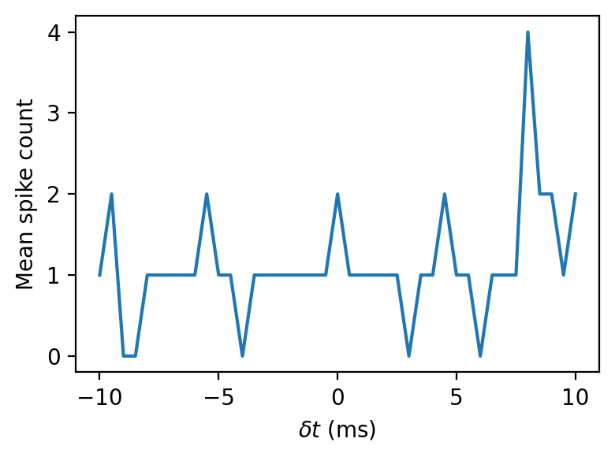
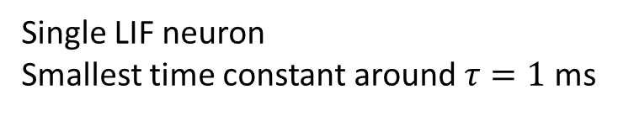
Single neuron and population sensitivity
Single LIF neuron
Smallest time constant around $τ=1$ ms
Network of neurons
Sensitive to time differences of a few microseconds
Notes:
OK that’s pretty much it for the sound localisation example, I just wanted to finish by highlighting what we’ve gained from the network here.
***
A single neuron has a time sensitivity controlled by its time constant, at the smallest around one millisecond.
And it has a lot of noise.
***
We’ve seen this curve, but that’s an average over ten thousand repetitions.
***
On a single trial it looks like this. Unlikely we could make a very accurate estimate from that.
***
By switching to a population and using a population level decoder we get a system that is sensitive to time differences of a few microseconds. Orders of magnitude more time sensitive than the speed of the fastest units in the network.

Slide 10
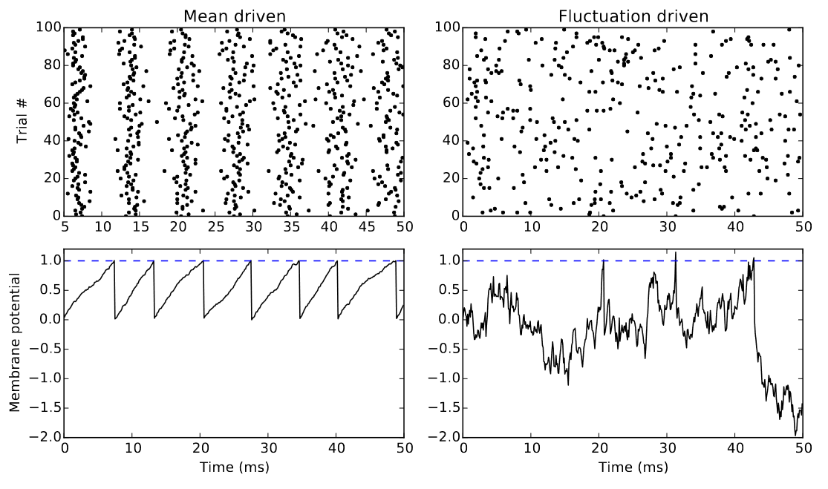
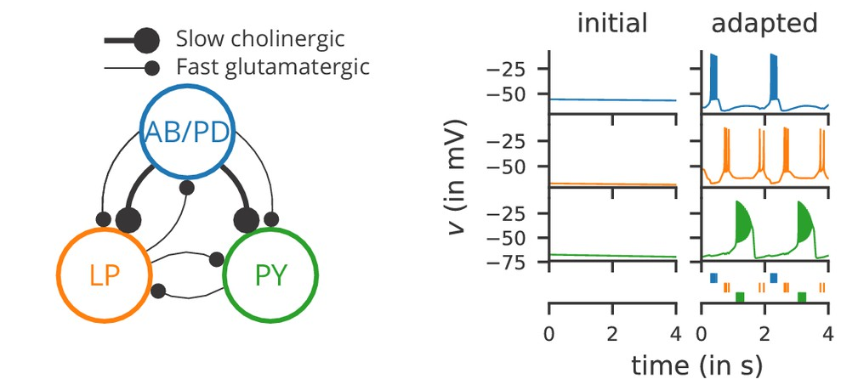
Various topics
Balanced excitation / inhibition
Central pattern generators
Goodman et al. (2018)
Later in the course: memory, decision-making, …
Notes:
As I said I can’t cover everything about networks here, so to finish off I just want to highlight two interesting things you might want to read up on further.
***
Cortical neurons receive thousands of tiny inputs per second, so why don’t they all fire very regularly like on the left of this figure?
One possible answer is that there is a balance of excitation and inhibition, and if excitatory and inhibitory inputs are balanced and randomly interspersed, a neuron can fire very irregularly.
You can see the effect of that on the right.
You actually see both types of behaviour in the brain, and having a range of such behaviours might be important. In this paper I look at different mechanisms that can contribute to that in the early auditory system.
More generally, some of the possible roles that have been suggested for balanced excitation/inhibition include improving the sensitivity, noise robustness and response speed of a network. There’s a big literature on this.
***
Another thing I personally find fascinating is central pattern generators. These are small networks that seem to just emit the same pattern of spikes on repeat forever. They’re thought to be involved in coordinating movements, basically providing a regular signal that can be transformed into stereotypical sequences that we need to move our muscles in standard patterns. Some of the circuits for this can be very simple, like this one shown schematically here in the lobster stomatogastric ganglion. This one is particularly interesting because it was found in modelling studies that there were many different parameters for this circuit that give the same output. And then later it was found experimentally that this is also the case in real lobsters: different individuals can have widely different neural properties in this circuit and still it functions in the same way.
I’ve put more reading on this topic and the others in this video in the reading list.
***
Also, we will be coming back to some other networks topics like memory and decision making later in the course.
OK, that’s all for now in networks. In the next video, I’ll introduce you to this week’s exercise.

